Slide 1
Pick Up
Drop Off
Yellow-Taxi Analysis in NYC
Presented by BILIBILI Business Intelligence Group
Notes:
The past year has been a PR nightmare for Uber, as the ride-sharing company has committed all sorts of blunders — legal and otherwise. Uber has been accused of sexual harassment, stealing trade secrets and profiteering off protests.

Slide 2
CONTENTS
Solution
What are you telling with your visualization? What is the story?
Who is the audience?
What are your deliverables?
Background
Part2
Lead with 10 words on why you chose this project
Why is your project interesting?
Why is your visualization important?
How is your visualization useful?
Part1
Technical Details
Part3
What are your design considerations?
How are you going to design, build, and evaluate?
How does your visualization compare to what others have done?
What are the components that make your visualization cool?
What are the technologies you plan to use?
How do you plan to use interactive visuals?
Teamwork
Part4
How do you work together?
What is your timeline?

Slide 3
CONTENTS
Background
Solution
Technical Details
Teamwork

Slide 4
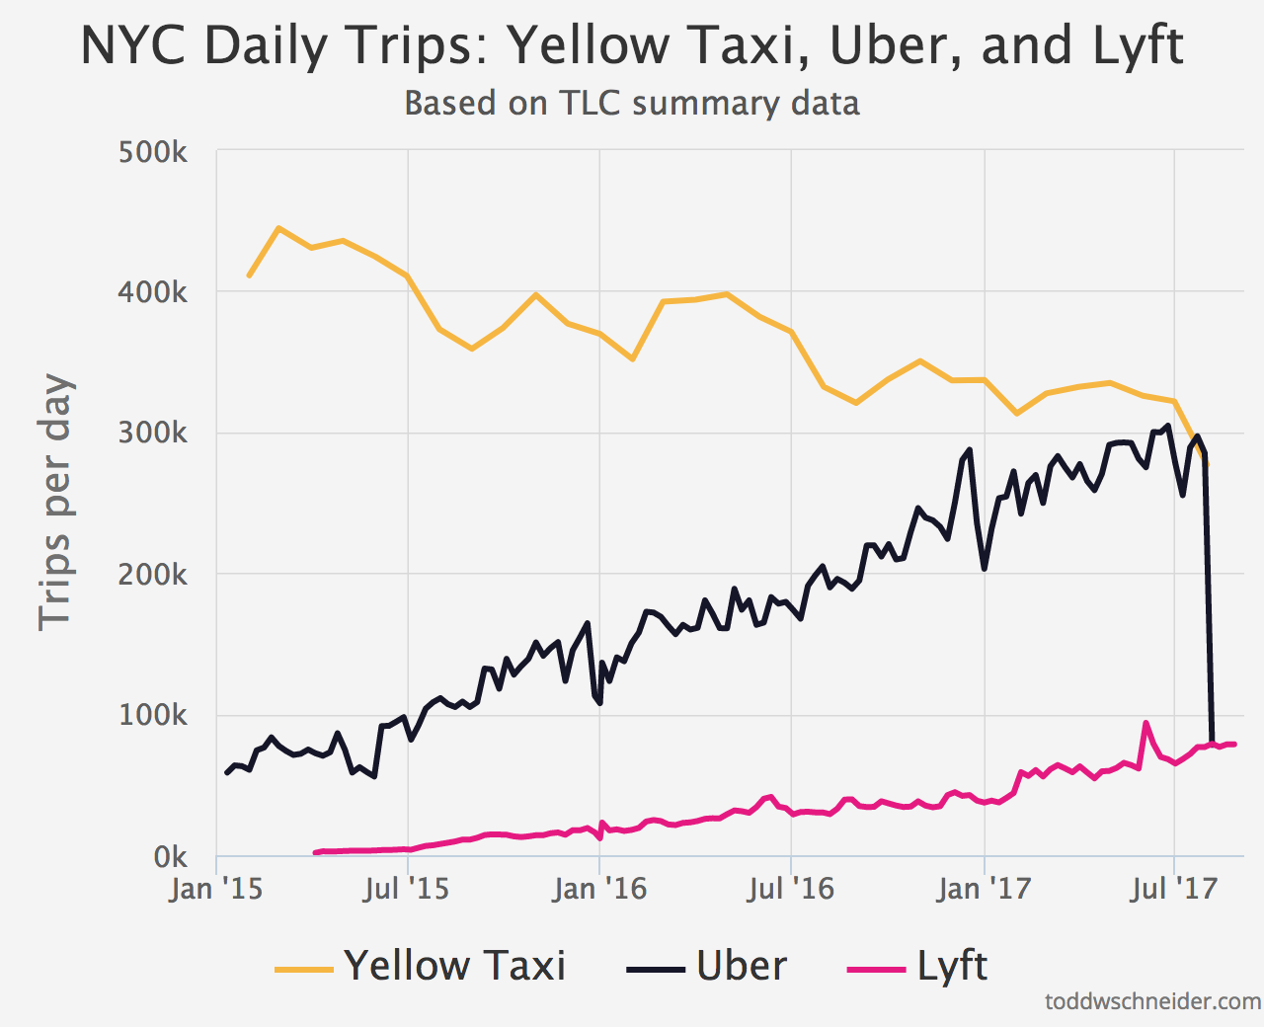
Background - Why we choose this topic
Volume
1.1 billion individual taxi trip
from Jan. 2009 to Jun. 2015
Veracity
LA(single) vs. NYC(multiple)
Notes:
According to The New York City Taxi & Limousine Commission, there are 1.1 billion individual taxi trips in the city from January 2009 through June 2015
The official TLC trip record dataset contains data for over 1.1 billion taxi trips from January 2009 through June 2015, covering both yellow and green taxis.

Slide 5
Background - Why interesting? How Useful? Why important?
How bad is the rush hour traffic from Midtown to JFK Airport?
Where does the Bridge and Tunnel crowd hang out on Saturday nights?
Our visuals address all of these questions and many more.
Interesting
What time do investment bankers get to work?
Useful
How has Uber changed the landscape for taxis?
Important
Could Bruce Willis and Samuel L. Jackson have made it from 72nd and Broadway to Wall Street in less than 30 minutes?

Slide 6
CONTENTS
Background
Solution
Technical Details
Teamwork

Slide 7
Solution – Who is the audience?
Ride-sharing service
Individuals
(especially for tourists)

Slide 8
Solution – Story Telling
What if ofo wants to enter into NYC after landed in Seattle?
How can Uber and Lyft extend market share?
Notes:
One day ….

Slide 9
Solution – What are the deliverables?
Interactive
Infographic
Paper
Video
Describe the
project
Scatter plot
Show
how to use
the infographic
Pie chart
Line chart
Chord graph
Slope graph
Notes:
a scatter plot : displays how the duration of trip changes with time, grouped by pairs of pick up and drop off location.
a line chart : displays the trend of numbers of trips begin in each zone.
a chord graph : compares the amount of trips from A to B and that from B to A.
a slope graph : compare the difference of trip amount between seven days in a week, grouped by zone of departure.
a pie chart : displays the partition of trips in a time interval(like morning peak and afternoon) with dif

Slide 10
CONTENTS
Background
Solution
Technical Details
Teamwork

Slide 11
Technical Details – How to design, build and evaluate?
Extract information
Choose vis techniques
Dimension wheel
Notes:
We would first look at the original data and see what information we can use, and then pick the proper visualization techniques. There are 265 zones in New York City, we want to show the timing data of transportation interval for each routes(for example, from time square to JFK airport). we would evaluate by checking whether it is easy for the user to reach the above information. And use the 6 dimension wheel for general design

Slide 12
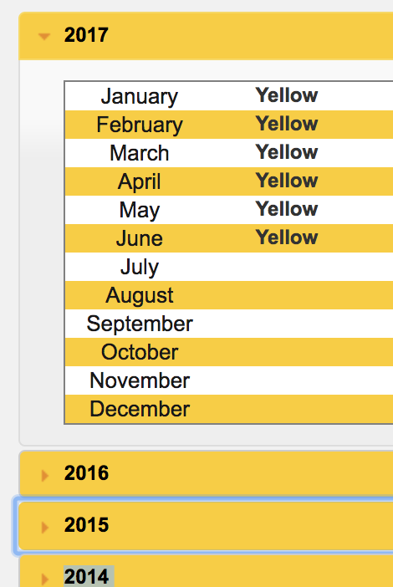
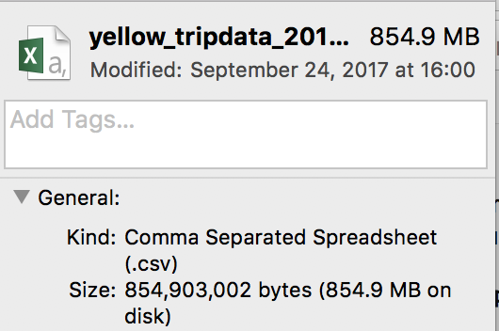
Technical Details – What are the design considerations?
Data preprocessing
Show large amount of information
Notes:
The original dataset is around 1gb per month, so the data must be preprocessed. Even after processing, we still have around 10 millions of data, we cannot show all the data within one static plot/graph. So we plan to implement several interactive tools like dragging and brushing, to spread the information into several plot.

Slide 13
Technical Details – What are the technologies you plan to use?
Visualization techniques: choropleth map, scatter plot, slope graph
Tool libs: d3-brush, d3-geoPath, etc.

Slide 14
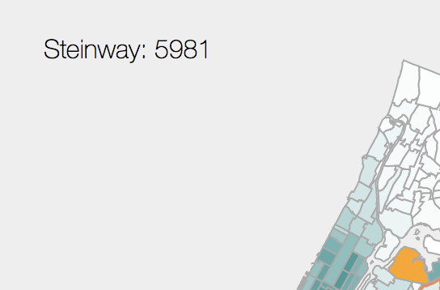
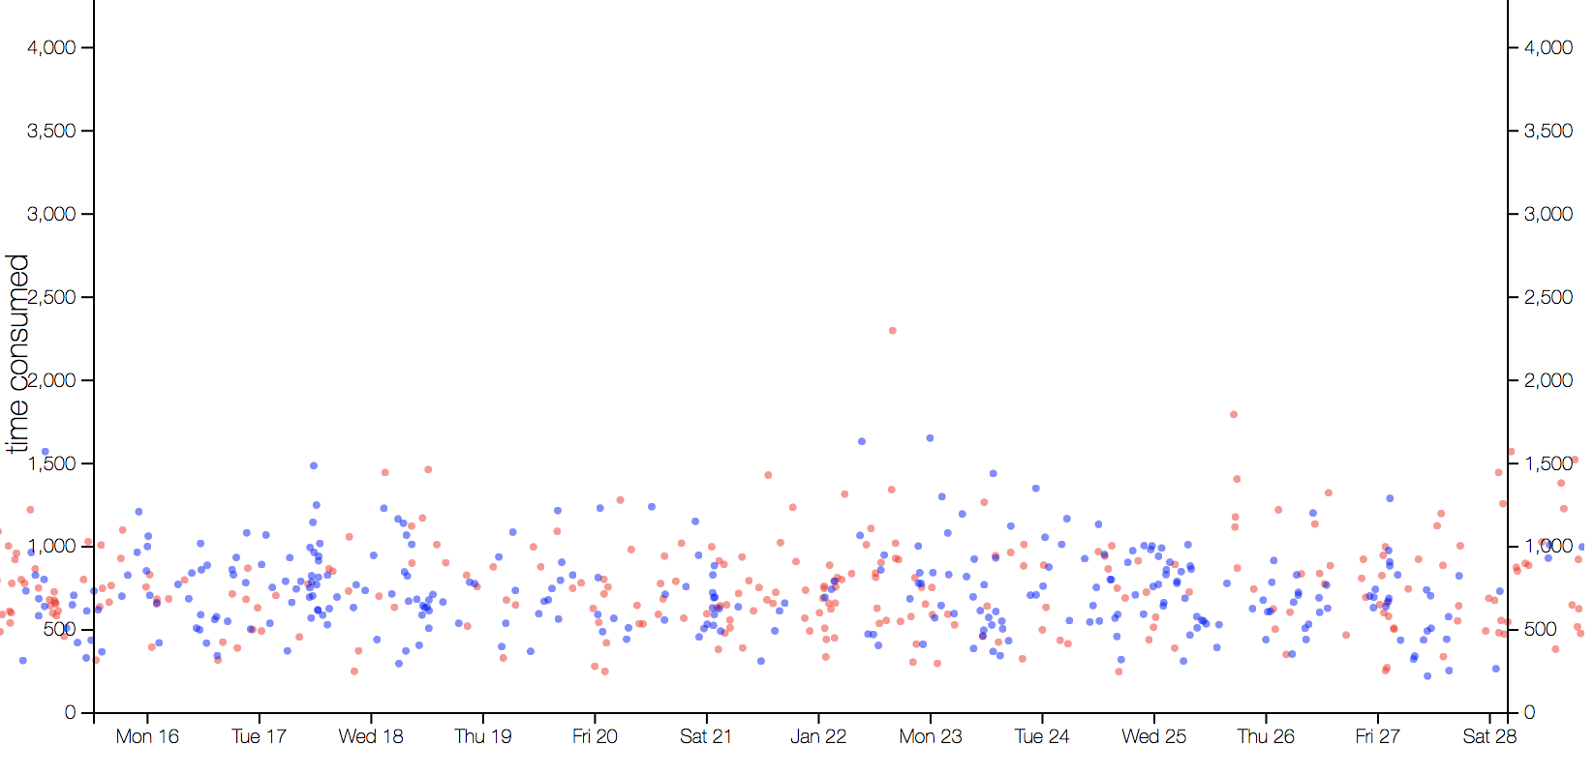
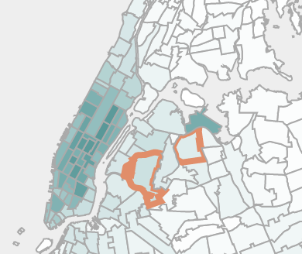
Technical Details – How to use interactive visuals?
Hover on each zone
Scroll: Zoom in/out the map
Drag on zone: Choose start and end zone.

Slide 15
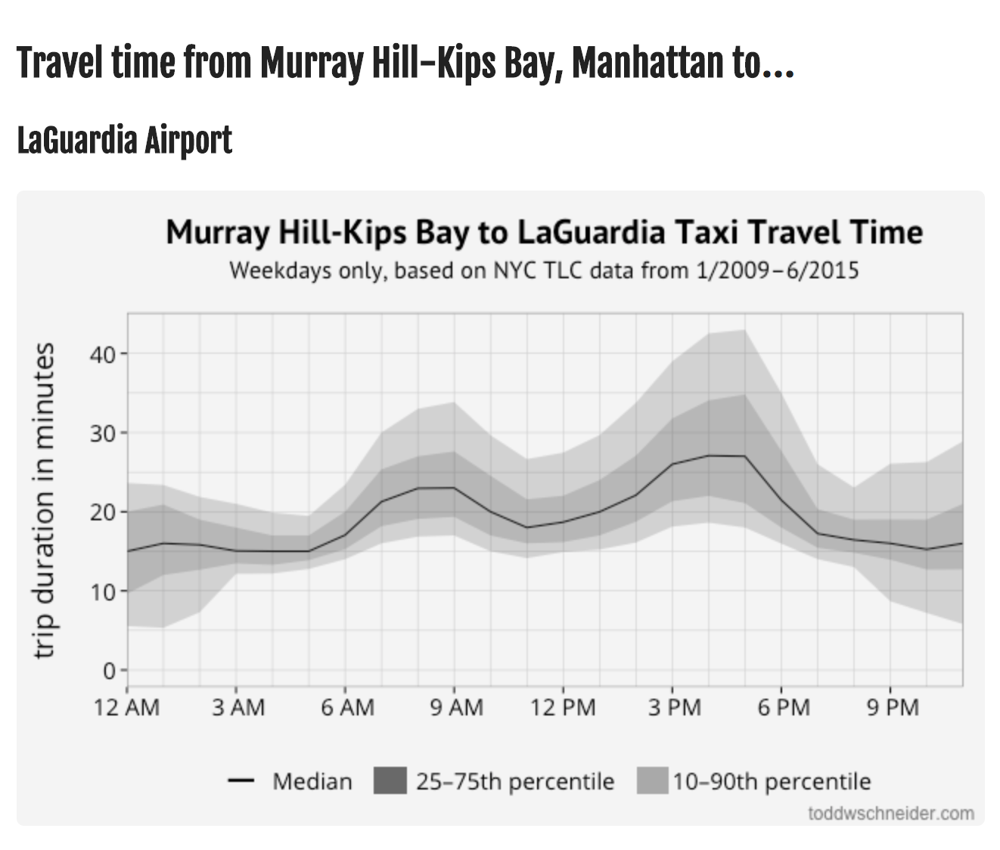
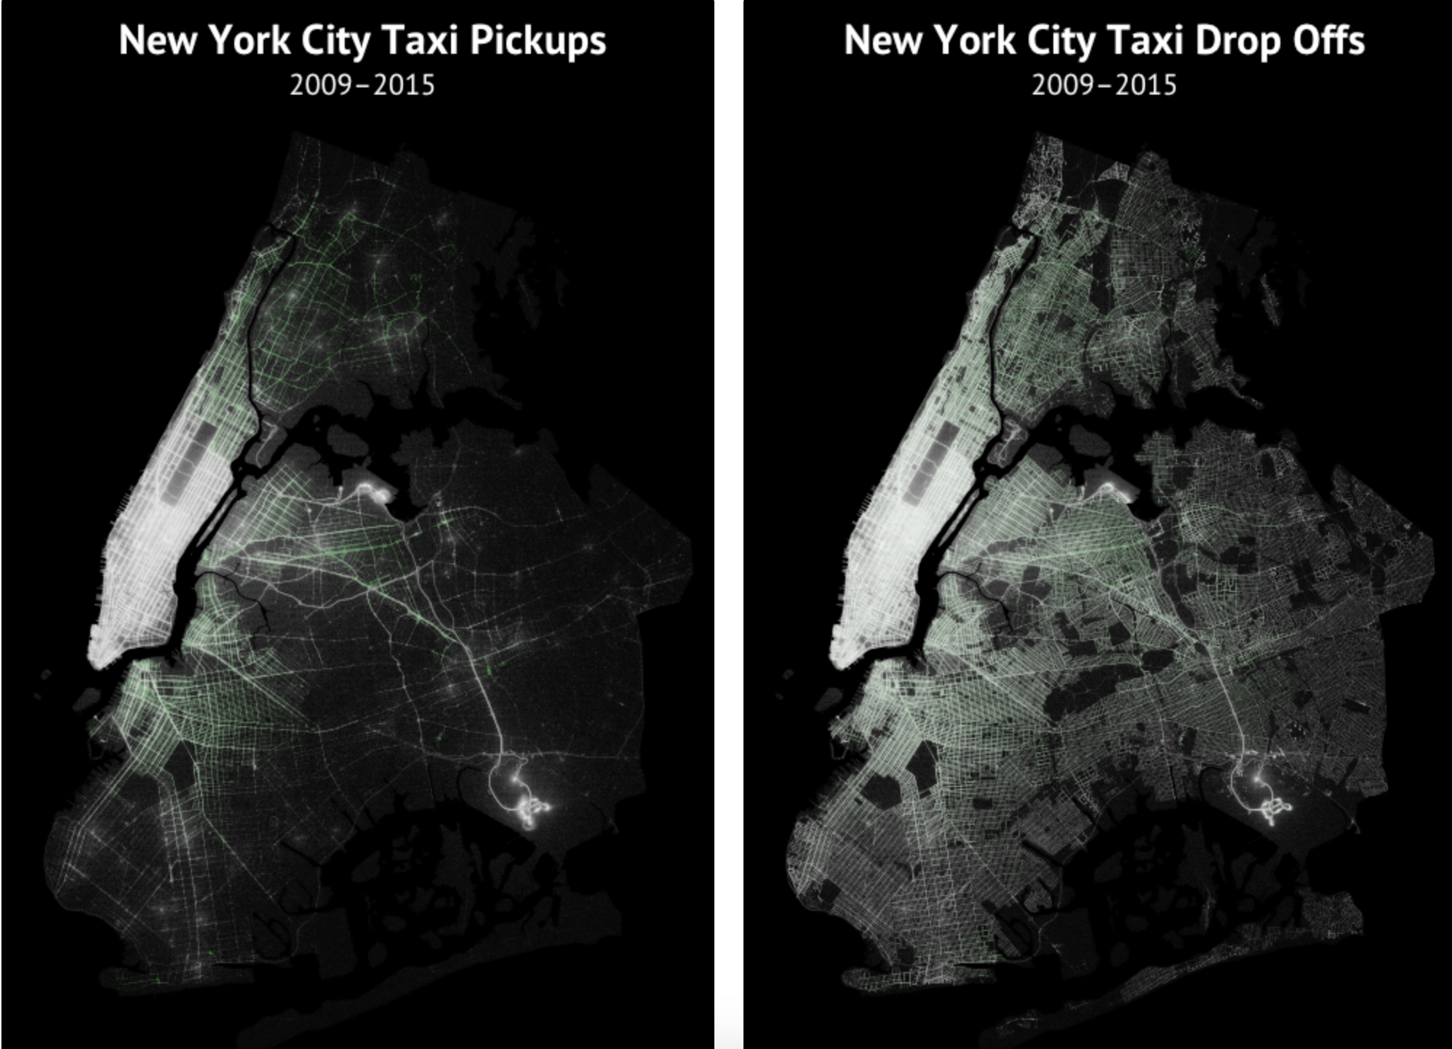
Technical Details – Comparison?
Notes:
there

Slide 16
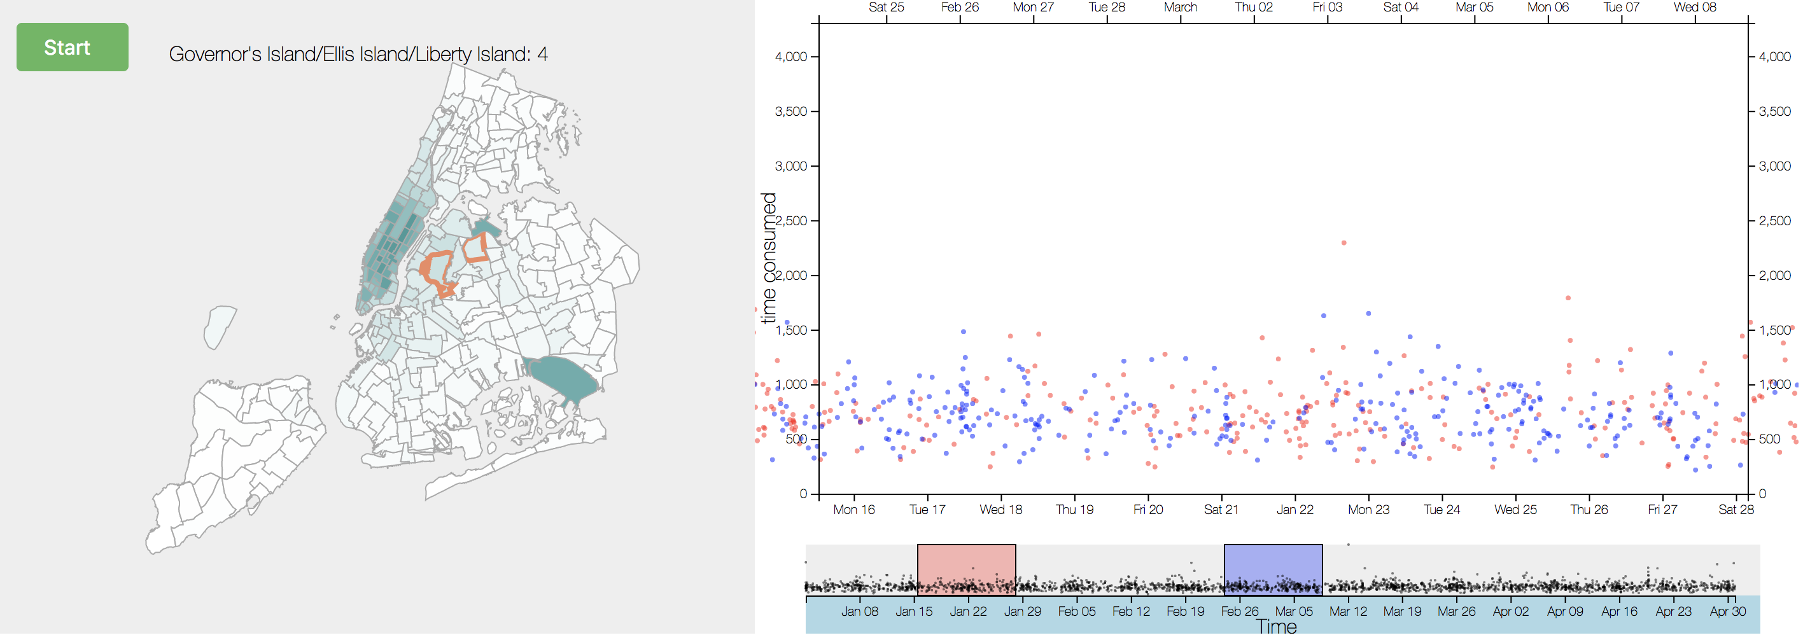
Technical Details – What’s cool?
multiple(two here) brushes to enable direct comparison

Slide 17
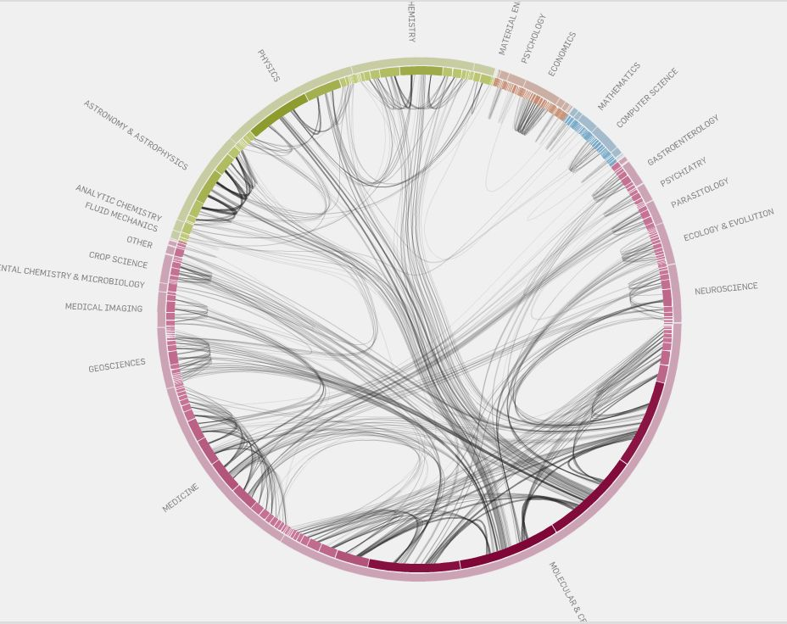
Technical Details – What’s cool?

Slide 18
CONTENTS
Background
Solution
Technical Details
Teamwork

Slide 19
Teamwork – How to work together?
Qingfeng Han
Dongqi Fu
Sudan Zhang

Slide 20
Teamwork – Timeline?
Develop infographic on website
Validate draft with critique groups
Write paper
Draw draft for infographic
Record video
Week1
Week2
Week3
Week4
Cleaning and formatting data
Acquire data
Presentation

